Slide 1
How do differences in income, gender, or location affect access to digital tools and online learning opportunities?

Slide 2
Executive summary
The report examines how people in Pakistan access online learning tools, what motivates their learning choices, and what prevents them from shifting from free to paid platforms.
Survey participants (ages 18–40) from major urban centers provided realistic insights into daily digital learning habits.
Strong interest in online learning exists, with most users relying on free, video-based platforms like YouTube for convenience and accessibility.
Internet quality is a major barrier, as many users experience slow speeds, buffering, and interruptions that reduce learning effectiveness.
Users are hesitant to purchase paid courses due to concerns about online payments, fraud risks, and doubts about certificate authenticity.
High-quality free content further reduces the perceived value of premium learning resources.
Improving internet reliability and introducing secure, locally trusted payment options would help strengthen adoption of paid e-learning platforms.

Slide 3
Introduction
Project Description
Examines how income, gender, and location affect digital learning access.
Uses a structured survey to study device access, internet quality, and platform use.
Identifies barriers to effective online learning and opportunities for improvement.

Slide 4
Scope of Study
Analyze links between employment and access to digital tools.
Evaluate gender differences in confidence and participation.
Assess how location affects internet quality and platform availability.
Examine financial, technical, and infrastructural challenges.
Summarize user experiences across demographic groups.
Report Format
Methodology: Survey design and respondent profile.
Findings & Analysis: Results by income, gender, and location.
Conclusions & Recommendations: Key insights and improvements for equitable digital access.

Slide 5
Literature Review (Key Insights)
Economic Inequality
Low-income students rely on shared devices & unstable internet [1][2].
Limited data plans & low-quality smartphones restrict high-bandwidth learning.
Gender Barriers
Girls face cultural restrictions, safety concerns, and limited digital freedom [3].
Lower encouragement in tech skills reduces confidence & participation [4].
Online harassment further discourages girls from learning digitally [5].
Notes:
[1] UNESCO, Global Education Monitoring Report: Technology in Education, 2023. [2] World Bank, “Poverty and Digital Learning,” 2022. [3] UNICEF, “Bridging the Gender Digital Divide,” 2021. [4] World Bank, “Girls’ Education and Women’s Empowerment,” 2022. [5] Plan International, The State of Girls in a Digital World, 2020.

Slide 6

Geographic Disparities
Rural areas have slower broadband, fewer providers, and higher costs [6].
Weak 4G coverage makes video-based learning difficult [7].
Rural students report frequent connectivity breakdowns during live classes [8].
Intersectionality & Research Gaps
Income + gender + location interact to intensify digital inequality.
Existing studies rarely examine combined effects on learning outcomes.
Need for integrated research to guide effective policy solutions.
Notes:
[6] PhoneWorld, “Rural Broadband Limitations in Pakistan,” 2024. [7] ITU, Measuring Digital Development: Facts and Figures, 2022. [8] Waqar, Rashid, Anis & Muhammad, “Digital Divide & Inclusive Education in Pakistan,” 2024.

Slide 7
ANALYSIS OF RESEARCH RESULTS
Employment & Online Learning Access
Device & Internet Access
Employed: 61% Wi-Fi use
Unemployed/Students: 75% broadband use
Both groups report similar internet quality (3.61 vs. 3.63)
Engagement & Constraints
Online course enrollment identical: 72% each
Employed: time constraints
Unemployed: financial + payment trust issues
Interpretation
Employment does not limit access, but barrier types differ.
Unemployed learners rely more on shared setups and face resource constraints.

Slide 8
Gender Impacts on Digital Learning
Accessibility & Economic Differences
Men more represented in high-income brackets
Women mostly in income “Below 50,000 PKR”
Financial limitations reduce female access to premium tools
Motivations & Platform Use
Men: career-driven (job, promotion, freelancing)
Women: studies, communication, foundational skill-building
Women rely heavily on YouTube & DigiSkills
Trust & Confidence Barriers
Both genders distrust online payments
Women affected more due to financial risk
Preference for free, low-risk platforms

Slide 9
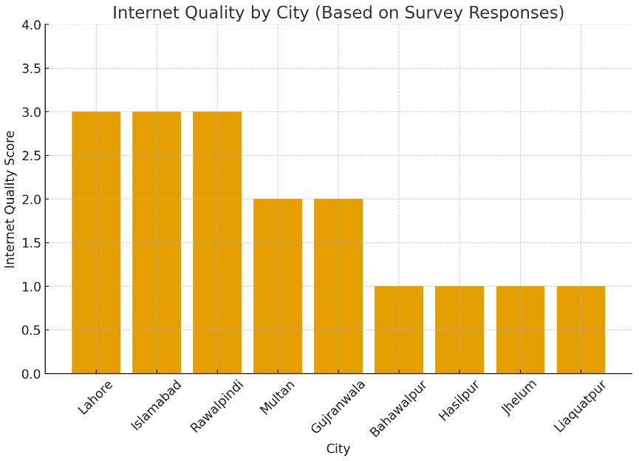
Geographic Impact on Digital Learning
Internet Quality & Stability
Metro internet quality: 3.69 avg
Regional internet quality: 3.36 avg
Regional users report more interruptions
Platform Preferences
YouTube dominant everywhere; highest use in regional areas
Metro users more likely to use Coursera/Udemy
Regional learners limited by bandwidth + cost
Familiarity & Feasibility
Metro: higher enrollment and tool familiarity
Regional: financial constraints + payment distrust reduce feasibility

Slide 10
Common Difficulties Reported by Learners
Financial Barriers
Cost is the most common reason for avoiding paid courses
High reliance on free platforms (YouTube, DigiSkills)
Certifications locked behind paywalls limit progression
Technical Difficulties
Frequent slow speeds, buffering, and connectivity drops
Regional quality lower (3.36 vs 3.69)
Technical issues exceed device or financial complaints
Infrastructural Obstacles
Regional areas face load shedding, poor reliability
Combined financial + infrastructure issues create compounded disadvantage
These barriers push learners toward asynchronous, low-bandwidth options

Slide 11

Conclusion and Recommendation
Conclusion
Income level determines digital access quality.
Lower-income users rely on mobile data/shared Wi-Fi causing interruptions.
Users avoid premium courses due to high cost and payment distrust.
Men use digital tools for career growth; women for studies/communication.
Women face stronger financial + confidence barriers, preferring free platforms.
Metro users have better internet; regional users face instability and load shedding.
Poor connectivity weakens synchronous learning across all groups.

Slide 12
Recommendations
Introduce secure, locally trusted payment systems for e-learning.
Provide low-bandwidth, downloadable, asynchronous course options.
Launch subsidized device + affordable data programs for low-income users.
Create digital confidence and safety programs targeted at women.
Invest in rural broadband upgrades and load-shedding-resilient infrastructure.

Slide 13

QUESTIONS?
Thankyou for your attention!

